Slide 1
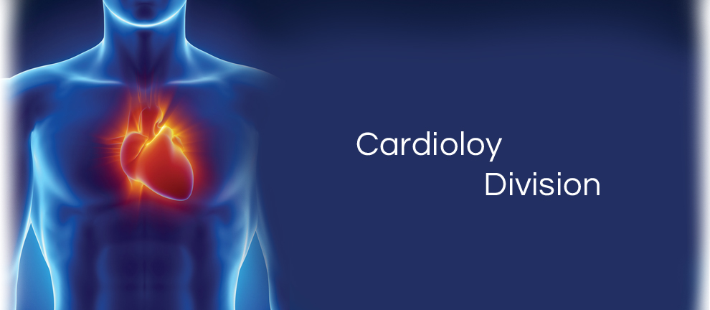
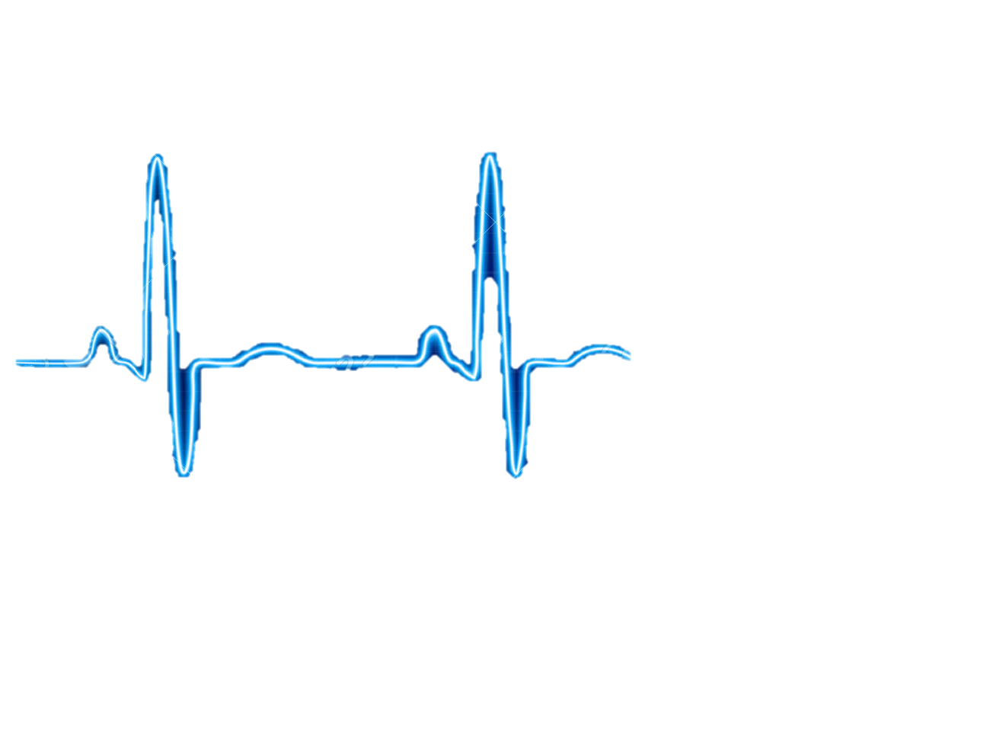
NEED FINDING
CARDIOVASCULAR TEAM
Qingbo Kang
Arthur Kohler
Chantelle Janeiro
Naghmeh Bandari
November, 2017

Slide 2
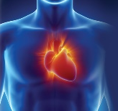

AGENDA
Team Members
Observations
Need Identification
Need Screening
Top Five Need Statements

Slide 3

TEAM MEMBERS
Naghmeh Bandari:
- PhD. Student of Mechanical engineering, Concordia University (2016-Now)
- Therapy Development Specialist, CoreValve® TAVI, Medtronic® lnc. (2010-2015)
- Commerce and Regulatory Affairs Supervisor, Thoratec Corp. (2007-2010)
Chantelle Janeiro:
Arthur Kohler:
Qingbo Kang:
- Master Student of Computer Science, Concordia University (2017-Now)

Slide 4
Observation
5 Hospital Visits
Two general visits, Glen Hospital, with Dr. Galli
One Coronary Artery Bypass Grafting (CABG), Glen Hospital, with
Dr. Lachapelle, Dr. Cecere
Two Transcatheter Aortic Valve Implantation (TAVI), Glen Hospital
With Dr. Lachapelle, Dr. Piazza

Slide 5
Need Identification
Total number of identified needs: 99

Slide 6
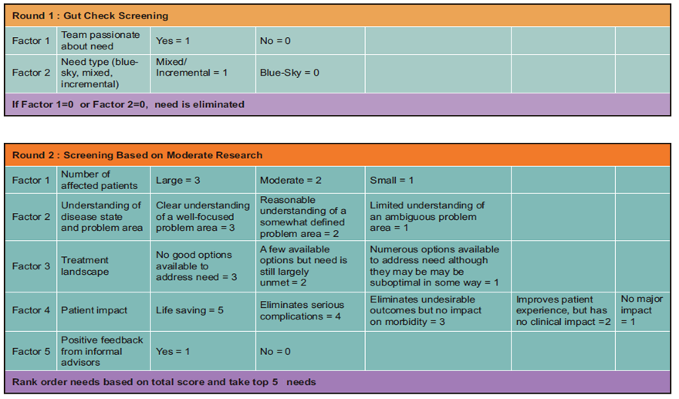
Number of Needs
Need Screening
99
25
5

Slide 7
Need 1:
A way to overcome the lack of wireless charging for medical devices that require an external power source, such as ventricle assist device, in patients with congestive heart failure, in order to improve convenience, maintenance, portability and quality of life.
Disease status:
Heart failure (HF) is a condition that the heart's pumping power is lower than healthy level. Consequently, the heart is not capable of pumping demanded oxygen and nutrients to the body.
At least 26 million patients worldwide
5.7 million people in the US
It is expected that by 2030 more than 8 million people will have this condition, with 46 % increase in prevalence

Slide 8
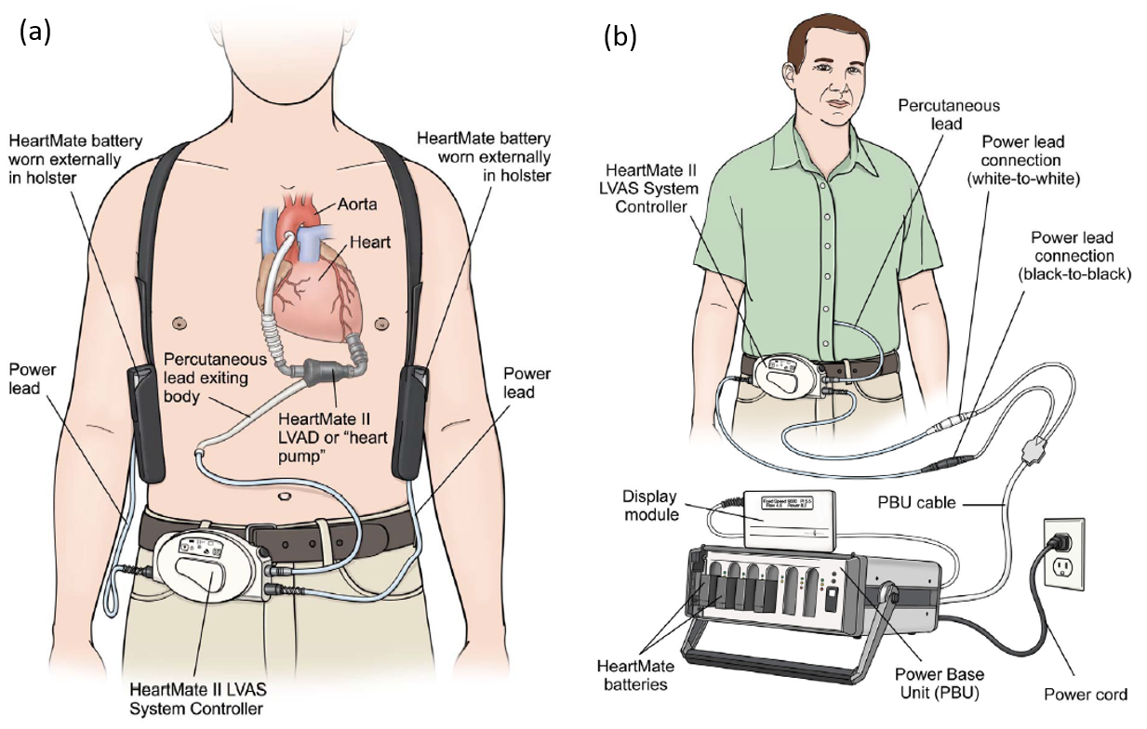
Need 1
Existing Treatment and Problem
Heart failure could be treated by Ventricle Assist Device (VAD), a small implantable device that act to compensate the pumping function of the heart and assist in circulating blood throughout the body.
VADs systems consist pump, system controller, power source, power leads, batteries and battery clips
VADs must always have power, either from batteries or electricity from the wall outlet
A power module or AC adaptor is used when the patient is not active, like when he is watching TV. It must be used when he is sleeping
Batteries should be exchanged when their charge falls below 25% capacity
Fully charged batteries should always be available or carried by backup bag

Slide 9
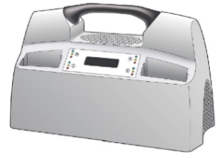
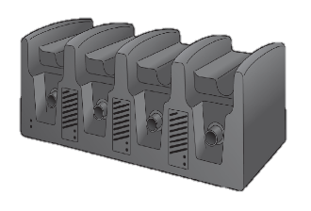
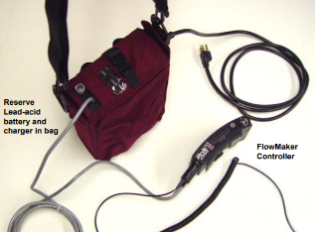
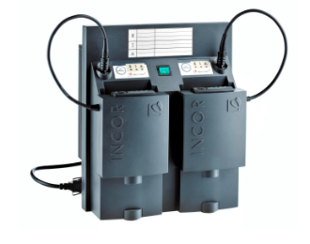
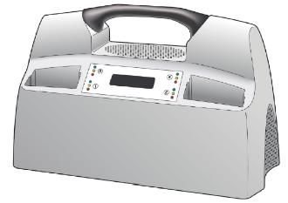
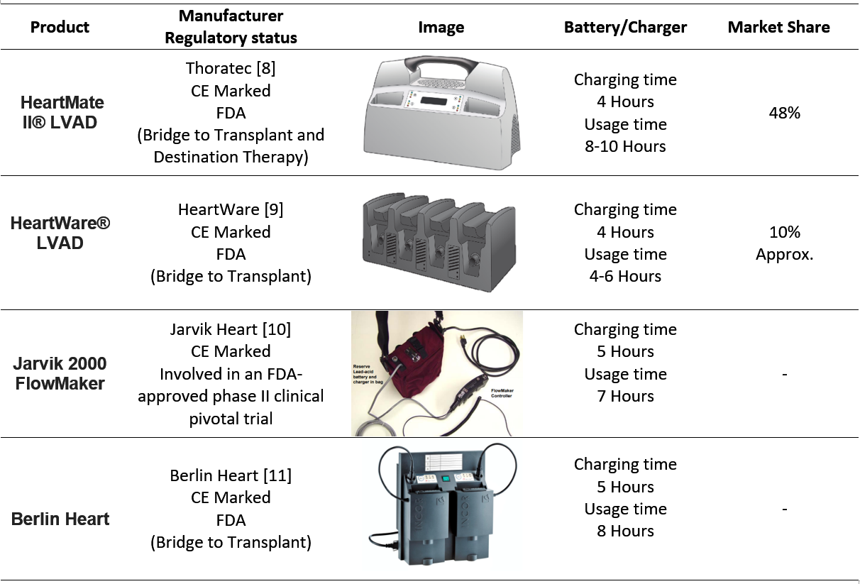
Need 1
Competitors

Slide 10
Need 1
Current Market for cardiac assistive devices
US | Global
770 Million | 1.4$ Billion | Market Value (2017)
10.9% | 8.6% | CAGR (2010-2017)
Classification and Applicable Regulations for battery chargers for VAD
FDA-CDRH | CE | HEALTH CANADA
Device Classification: 1 Product Code: KRF Regulation Number: CFR 870.3670 | Device Classification: I Regulation: EEC/2017/745 | Device Classification: I Regulation: CMDCAS
Need Criteria:
the proposed need is subjected to the following criteria:
Lightweight, easy to carry
No need to backpack for reserve battery set
Firmware to track flows and battery charge with phone application

Slide 11
Need 2:
A way to reduce the tediousness of counting surgical instruments in every surgery, which will increase the efficiency of medical procedures, lighten the workload of operating room staff, and decrease surgical complications caused by human error.
Background:
Counting all surgical instruments before and at the end of surgery is an important process for every surgery.
Retained surgical instrument (RSI) could lead to severe problems to patients.
At present, the surgical instruments counting process generally is undertaken by human, thus, mistakes is inevitable.
Mistakes in instruments counts happened in 12.5% of surgeries. – Annals of Surgery

Slide 12
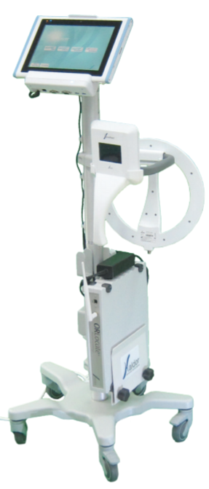
Need 2
Existing Treatment and Problem
Israel RFID (radio frequency identification) medical solution provider Haldor Advanced Technologies developed ORLocate system based on passive RFID tags, it can monitor and track the surgical instruments before, during and at the end of the surgical procedure.
Penelope robot system designed by Micheael R.T can also count surgical instruments.
Most existing solutions are based on ceramic RFID tag.
Need to change the manufacturing process of surgical instruments.
Complex and the price is pretty high.

Slide 13
Need 2
Market and Competitors
48 million surgical inpatient procedures were performed in the United States in 2009. – National Center for Health Statistics
The number of cases in which surgical instruments are left behind during a procedure in the United States has been estimated at around 1500 cases per year, while approximately 88% of these cases occur in a situation where the surgical instruments counts were declared “correct”.
The compensation costs associated with RSI are high. Costs vary from $37,041 to $ 2,350,000 per incident, with an average cost per case estimated at $95,000.
48 million surgical inpatient procedures were performed in the United States in 2009. – National Center for Health Statistics
The number of cases in which surgical instruments are left behind during a procedure in the United States has been estimated at around 1500 cases per year, while approximately 88% of these cases occur in a situation where the surgical instruments counts were declared “correct”.
The compensation costs associated with RSI are high. Costs vary from $37,041 to $ 2,350,000 per incident, with an average cost per case estimated at $95,000.
A more accurate and efficient surgical counting approach would help to save these costs and benefit to both patients and hospitals.

Slide 14
Need 2
Classification and Applicable Regulations
FDA-CDRH | CE | HEALTH CANADA
Device Classification: 1 Product Code: Regulation Number: | Device Classification: I Regulation: EEC/2017/745 | Device Classification: I Regulation: CMDCAS
Need Criteria:
The aiming approach should not change the fabrication process of surgical instruments.
The aiming approach should be more accurate than these existing approaches.
The aiming approach should be easy to use.
The aiming approach should be low-cost.

Slide 15
Need 3:
Disease status:

Slide 16
Need 3
Existing Treatment and Problem

Slide 17
Need 3
Market and Competitors

Slide 18
Need 3
Classification and Applicable Regulations
FDA-CDRH | CE | HEALTH CANADA
Device Classification: 1 Product Code: Regulation Number: | Device Classification: I Regulation: EEC/2017/745 | Device Classification: I Regulation: CMDCAS
Need Criteria:

Slide 19
Need 4:
Disease status:

Slide 20
Need 4
Existing Treatment and Problem

Slide 21
Need 4
Market and Competitors

Slide 22
Need 4
Classification and Applicable Regulations
FDA-CDRH | CE | HEALTH CANADA
Device Classification: 1 Product Code: Regulation Number: | Device Classification: I Regulation: EEC/2017/745 | Device Classification: I Regulation: CMDCAS
Need Criteria:

Slide 23
Need 5:
Disease status:

Slide 24
Need 5
Existing Treatment and Problem

Slide 25
Need 5
Market and Competitors

Slide 26
Need 5
Classification and Applicable Regulations
FDA-CDRH | CE | HEALTH CANADA
Device Classification: 1 Product Code: Regulation Number: | Device Classification: I Regulation: EEC/2017/745 | Device Classification: I Regulation: CMDCAS
Need Criteria:

Slide 27
CARDIOVASCULAR TEAM
Thank You…

